Slide 1



Paulding county high school cosmetology department
Choose a Career Pathway

Slide 2
Welcome
Human Services Cluster
Intro Personal Care Services
Cosmetology II
Cosmetology III
Educator/Teacher: Mrs. L. Slay

Slide 3
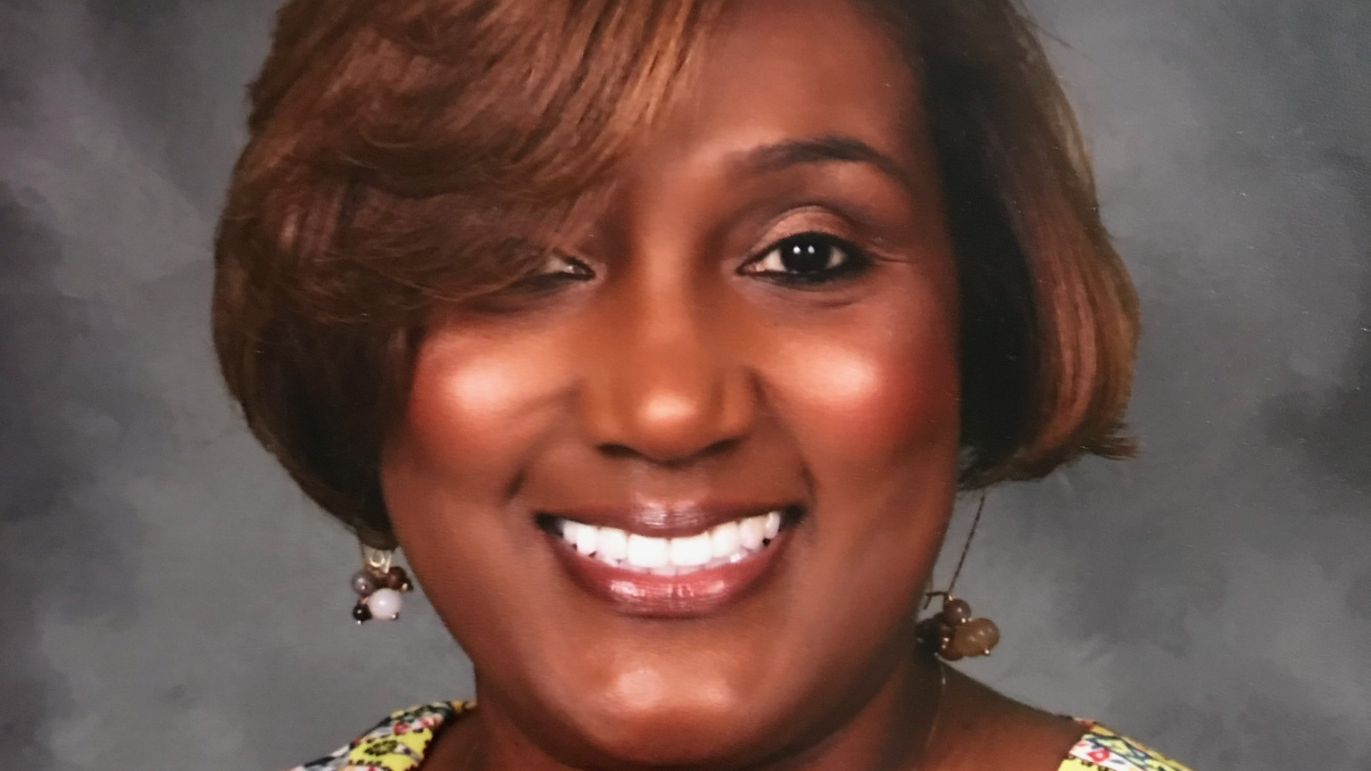
Teacher
Mrs. L. Slay
lslay@Paulding.k12.ga.us
https://slaycosmetology.weebly.com/

Slide 4
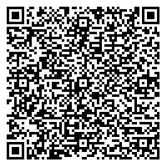
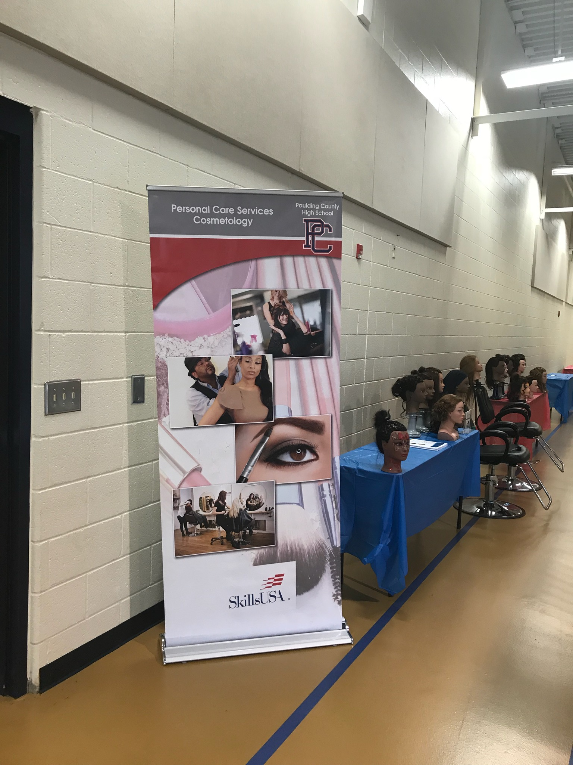
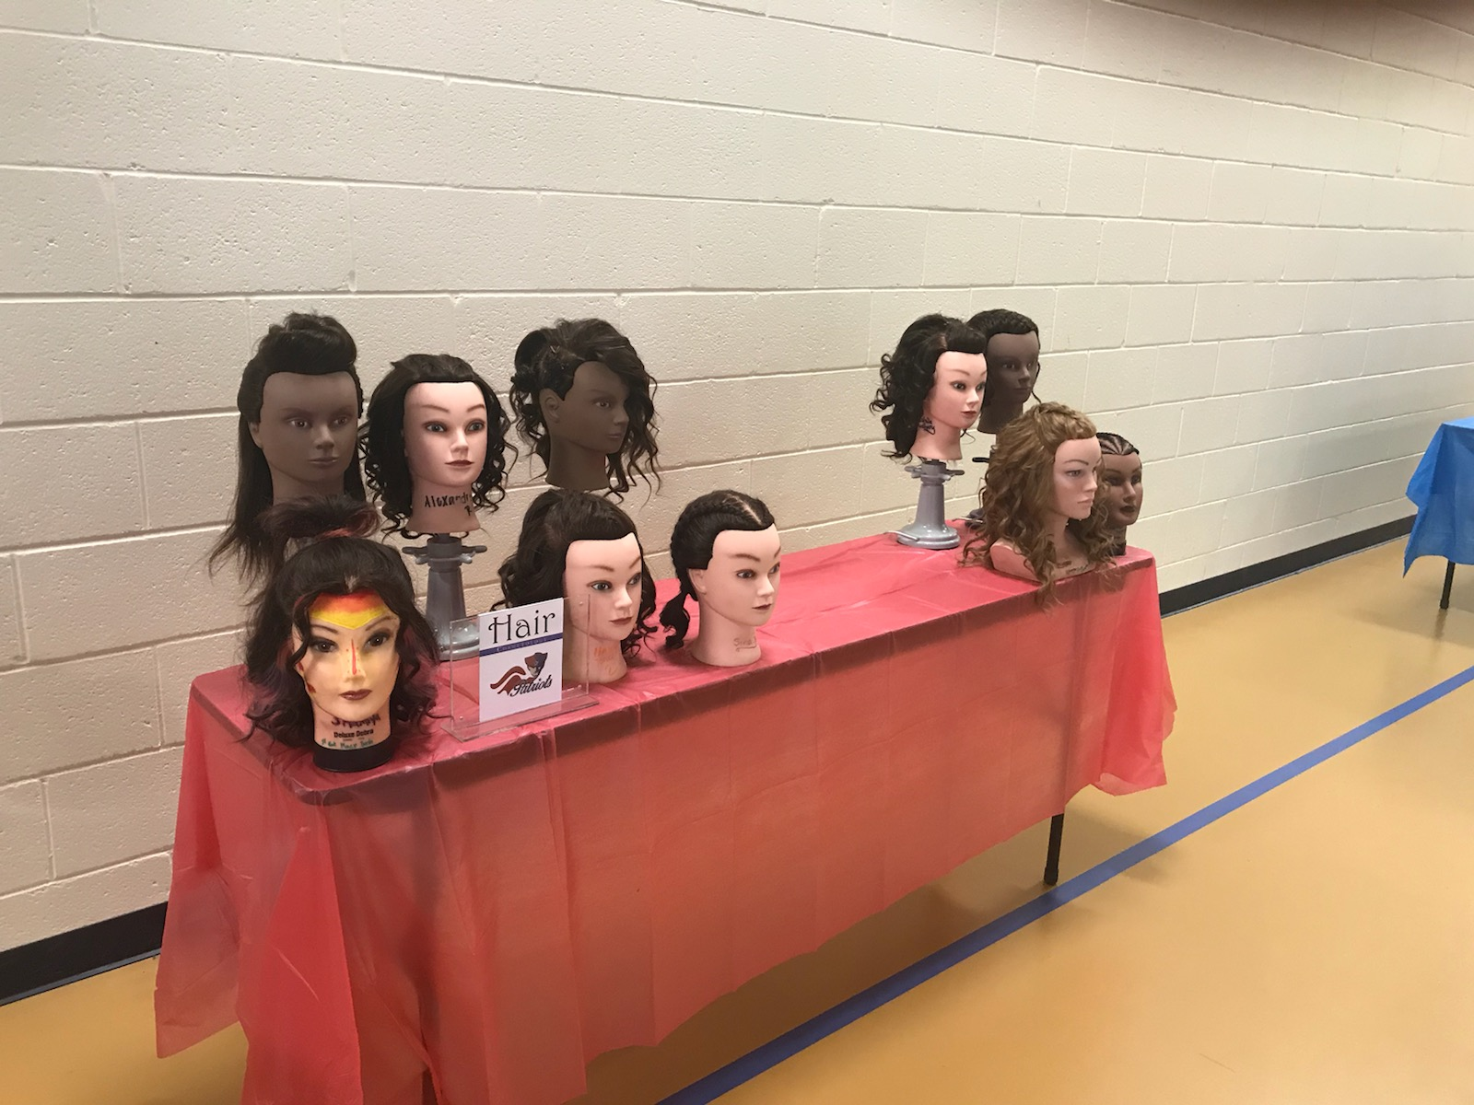
Choose a great pathway
Contact info
Choose a Career
Paulding County High School
Cosmetology Department
1297 Villa Rica Hwy
Dallas, GA
Learn skills
Fun
Get motivated
Build self-esteem
Learn time management
Be creative

Slide 5
Cosmetology – Three Semester Pathway
The three semester pathway courses are designed to introduce students to the cosmetology profession. State Board requirements including safety measures and infection control are introduced. Effective listening, communication skills and professional ethics are emphasized on a daily basis. Students will demonstrate the applications of curling, waving, haircutting, chemical processes, nail care and skin care. They may transfer credit hours they have earned to a private or technical school.

Slide 6
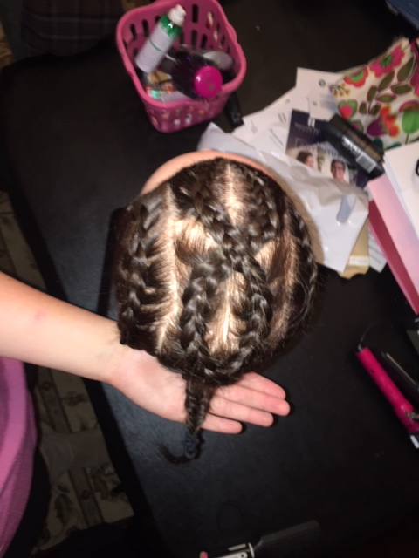
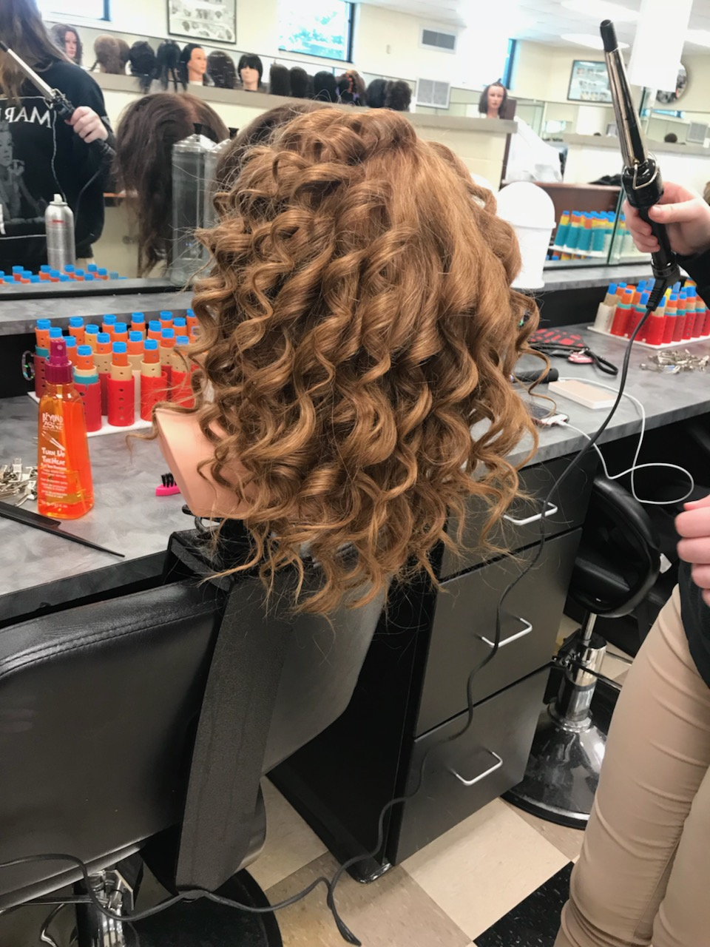
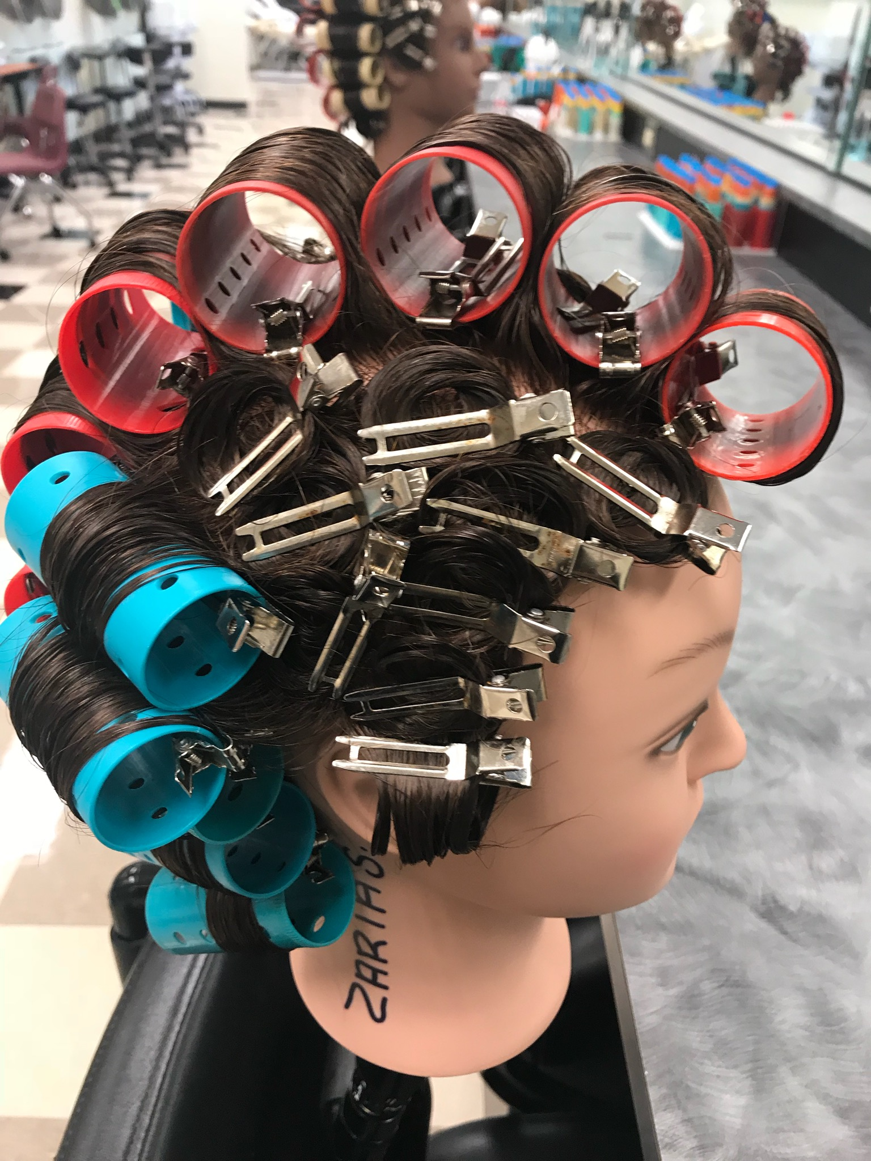
Snapshots of slays salons
Roller set and pin curls
Curls, curls and curls
Dutch Braiding

Slide 8
Cosmetology II
Course Description
Cosmetology II is the second course in the Cosmetology program of study intended to prepare students for careers in cosmetology by developing an understanding of efficient and safe work practices, nail procedures, hair design, and chemical services. Students will gain experience in practical applications of cosmetology practices. Laboratory facilities and experiences simulate those found in the cosmetology industry.

Slide 9
Cosmetology III
Course Description
Cosmetology III is the third course in the Cosmetology program of study intended to prepare students for careers in cosmetology by developing an understanding of efficient and safe work practices, salon business concepts and operations, advanced hair techniques and chemical services, and facial and skin care procedures. Students will gain experience in practical applications of cosmetology practices. Laboratory facilities and experiences simulate those found in the cosmetology industry.

Slide 10
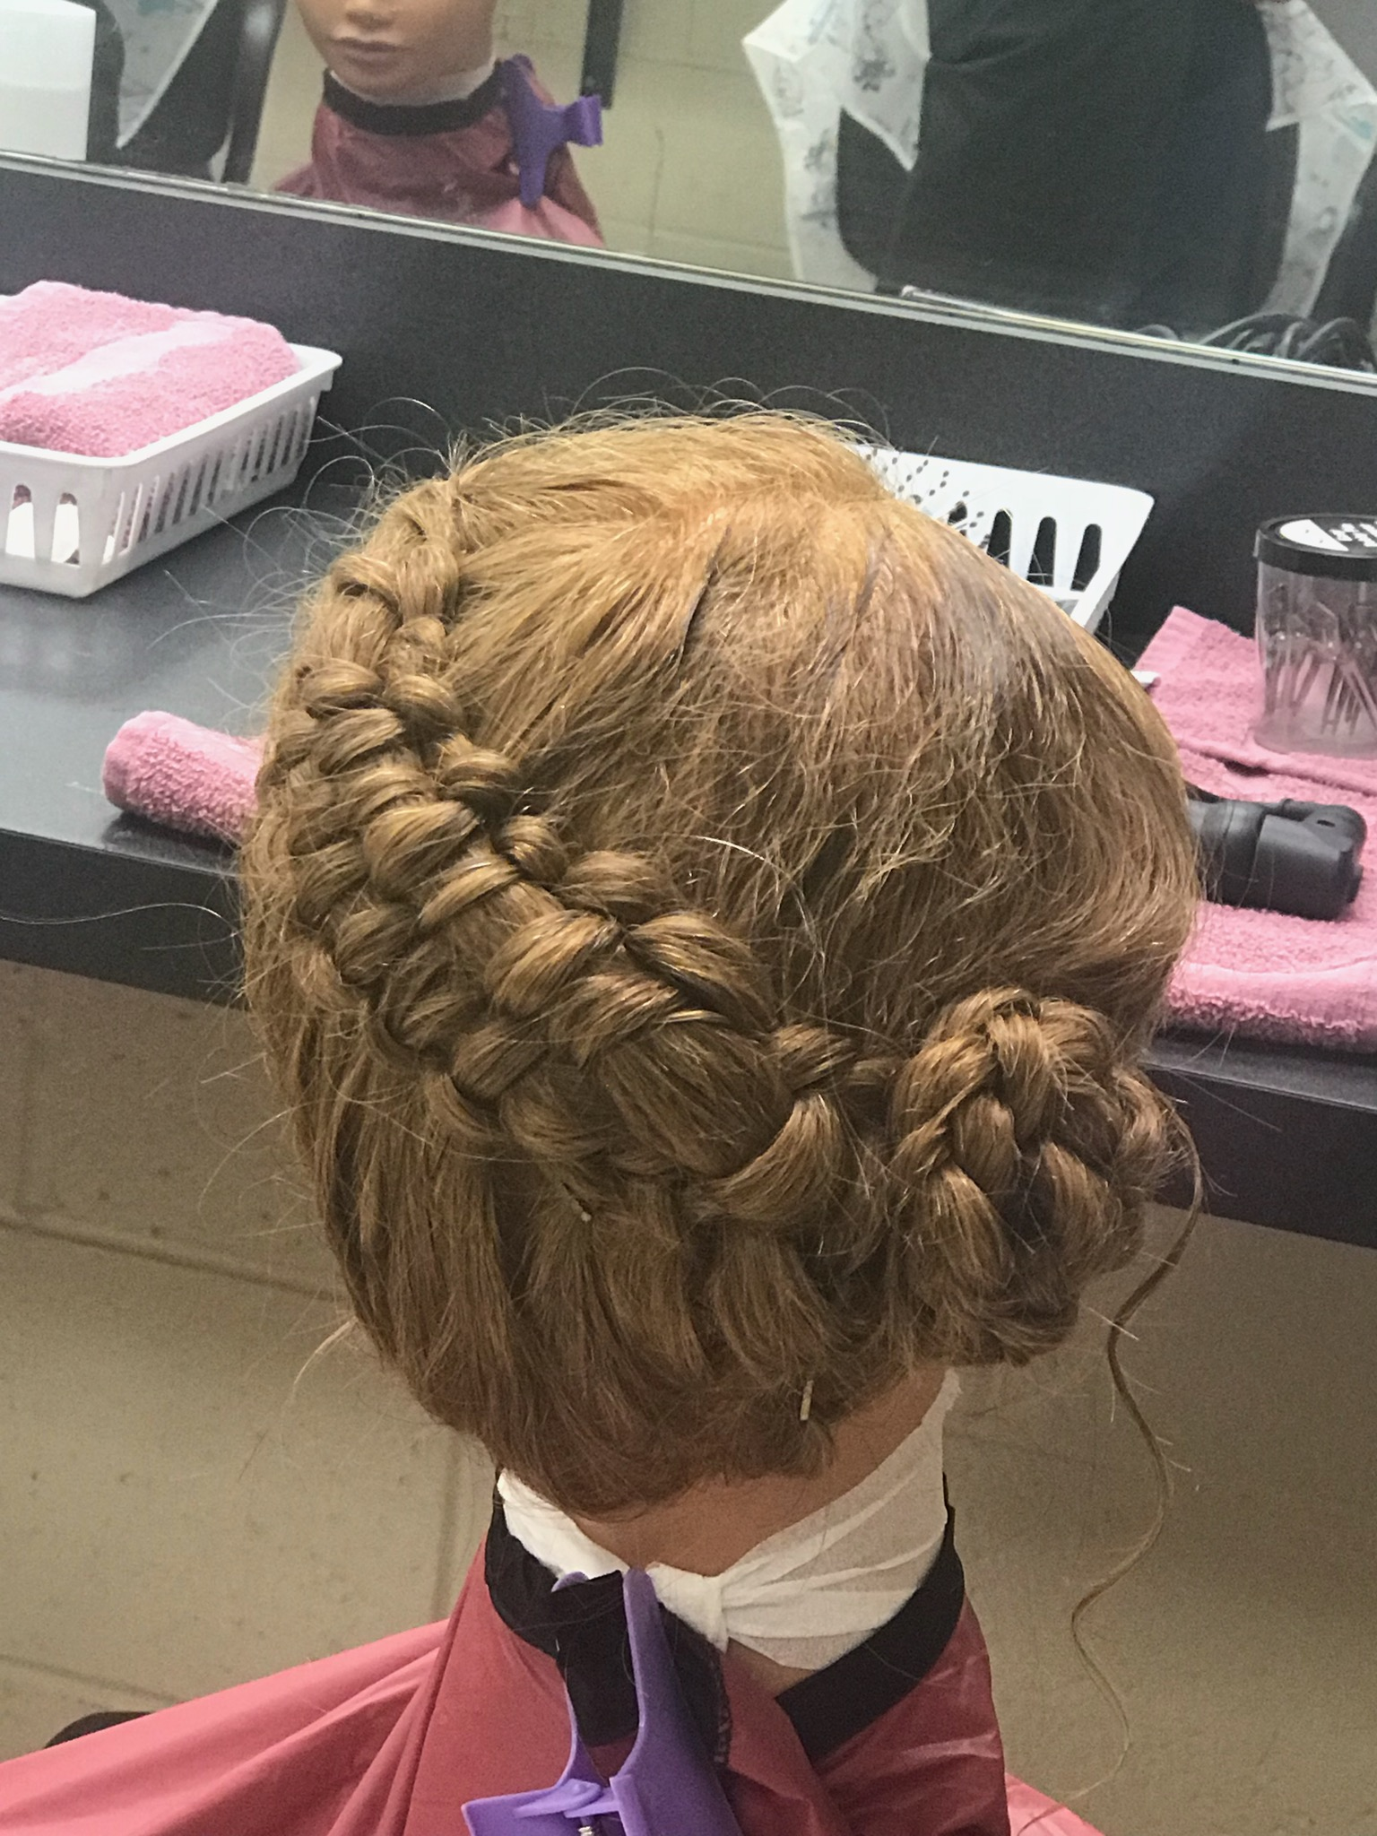
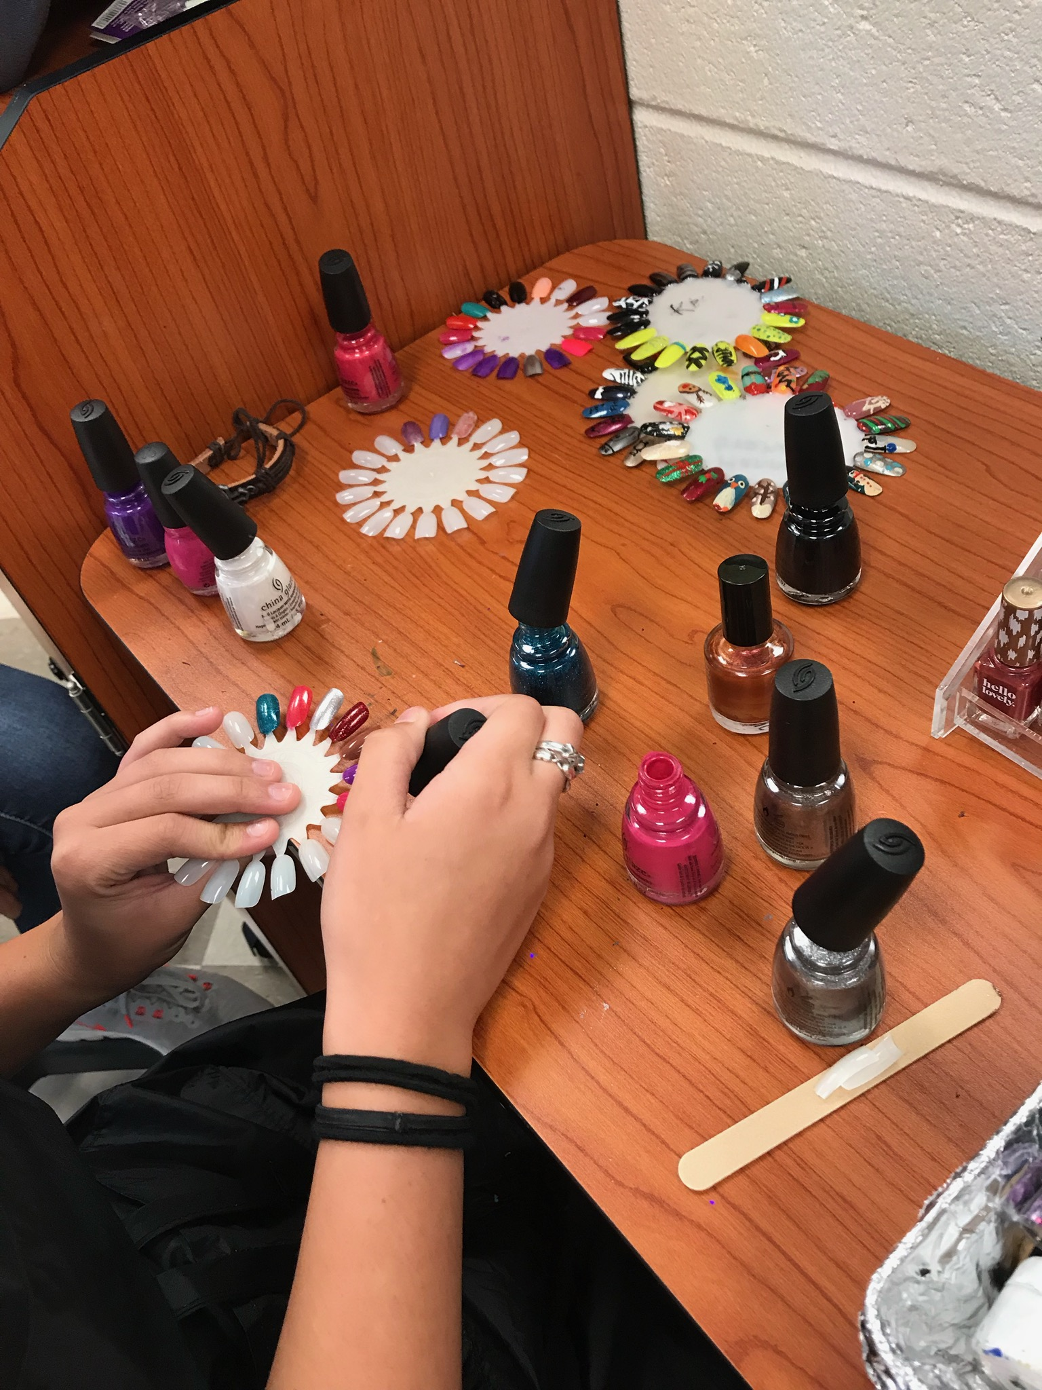
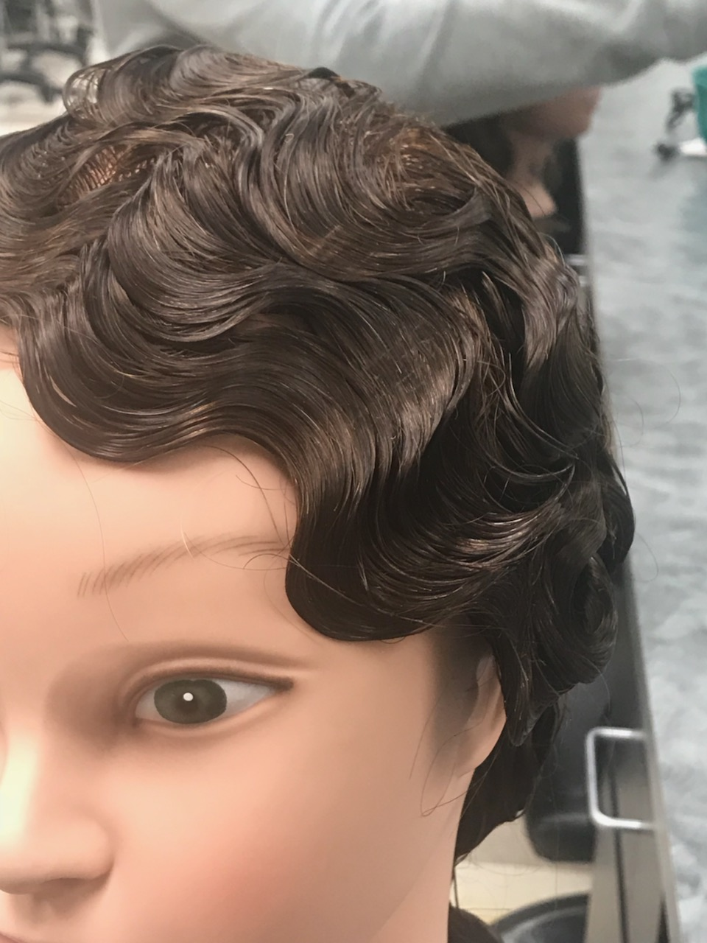
Slay salons
BRAIDING STYLISH
BRAIDING STYLISH
NAILS
Finger waves

Slide 11
I think I will choose this career pathway!
PCHS COSMETOLOGY DEPARTEMENT
Mrs. Slay’s Class

